Slide 1
MSK-
CONGENITAL ANOMALIES
www.drtehreemfatima.com
Dr Tehreem Fatima
Registrar Radiology

Slide 2
Chondrodystrophia ossificans
www.drtehreemfatima.com
Chondrodysplasia punctata
Dysplasia Epiphysiealis punctata
Stippled Epiphysis

Slide 3
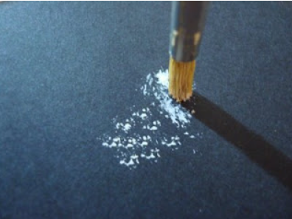
www.drtehreemfatima.com
Rare congenital syndrome
Peroxisomes
Calcific stippling of cartilage and peri-articular soft tissues is often a common feature.

Slide 4
types
Rhizomelic Type
  Usually lethal
  Most common
  Ichthyosis may be seen
Non-Rhizomelic Type
  Brachytelephalyngic
  Conradi Hunerman Syndrome
  X-linked dominant > severe in males
www.drtehreemfatima.com

Slide 5
RADIOGRAPHIC FEATURES
Punctate calcifications
              Tarsus & carpus
              Long bone epiphysis
              Vertebral Transvers processes
              Pubic bones
Misshapen epiphysis, asymmetrical limb shortening.
Scoliosis
www.drtehreemfatima.com

Slide 6
Recessive type
More severe form >> death in 1st yr of life
Survivors >> mentally defective
Stippling of bones plus trachea
Vertebral bodies >> clefting
www.drtehreemfatima.com

Slide 7
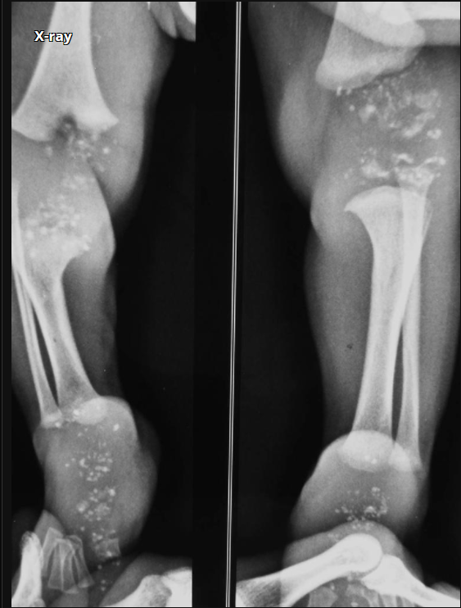
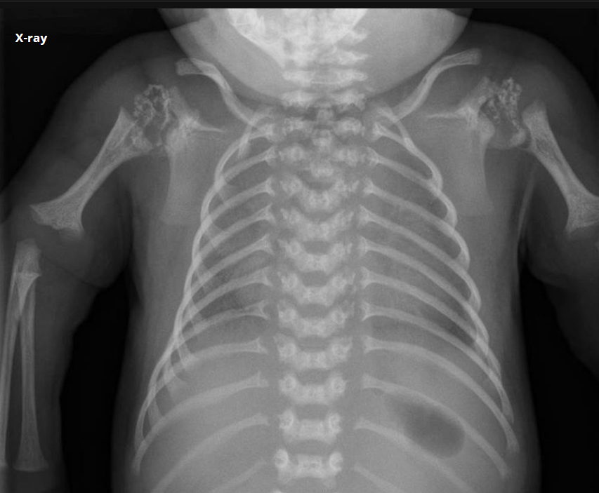
www.drtehreemfatima.com
There are innumerable punctate calcific deposits in all epiphysis.
Short humerus (rhizomelic) & mild metaphyseal flaring of distal humerus.

Slide 8
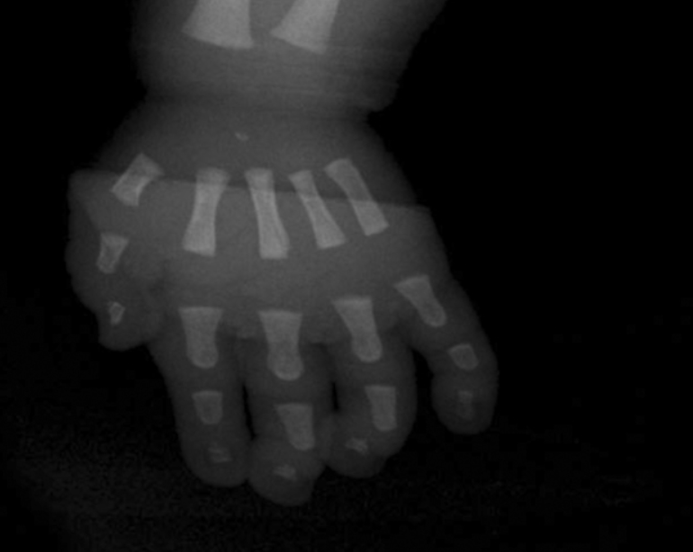
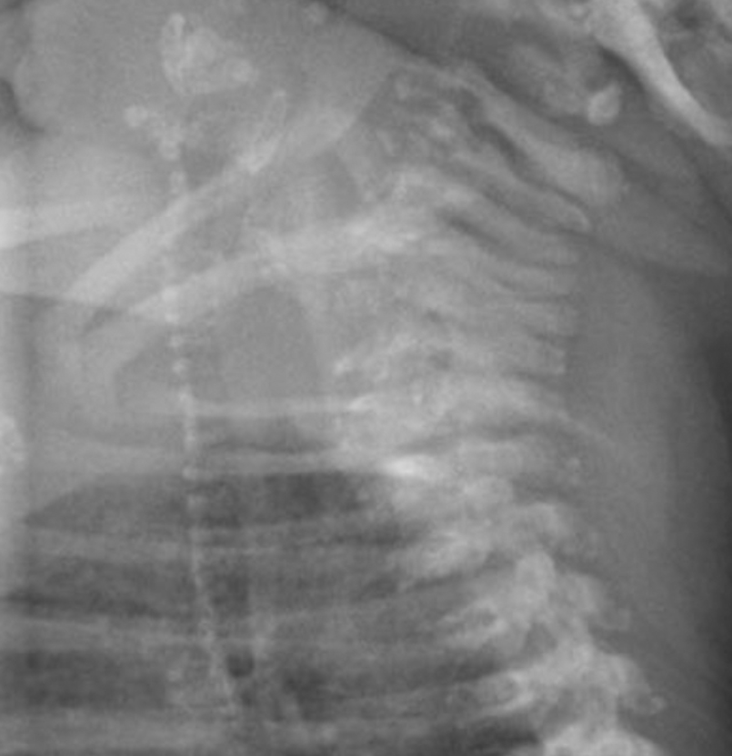
www.drtehreemfatima.com

Slide 9
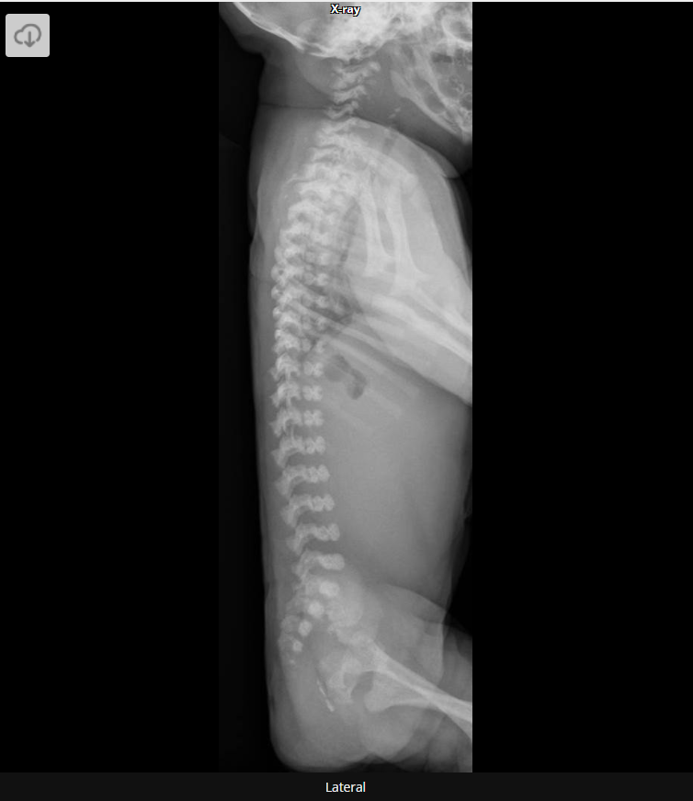
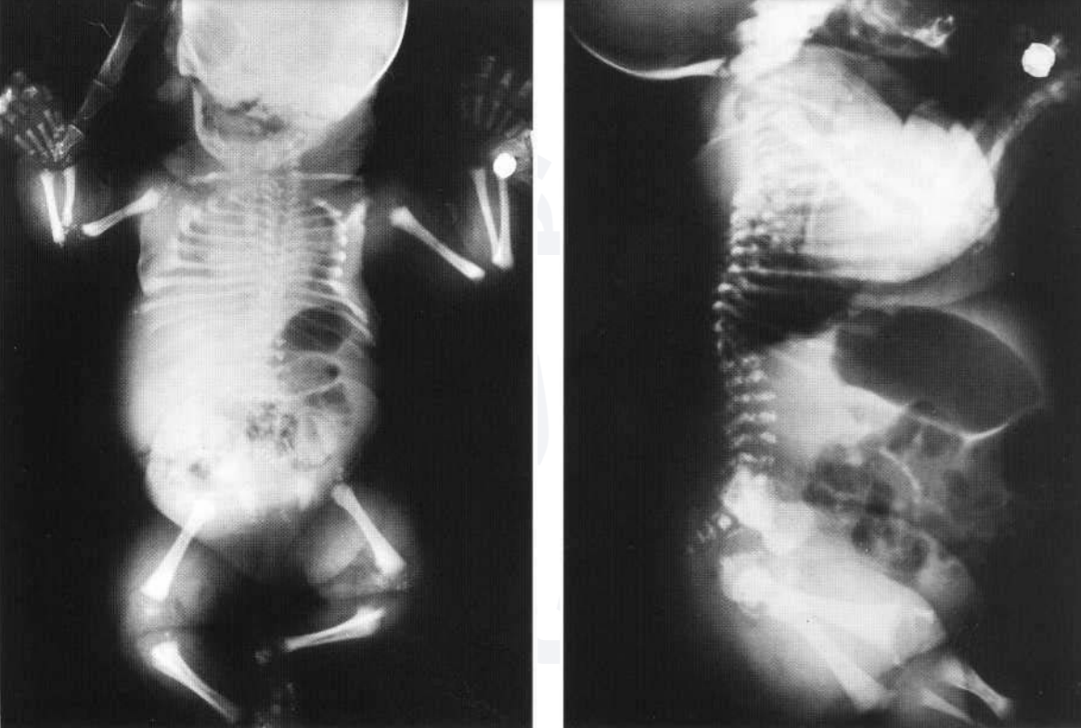

Slide 10
MULTIPLE EPIPHYSEAL DYSPLASIA
www.drtehreemfatima.com
Dysplasia Epiphysealis Multiplex

Slide 11
Autosomal dominant
Primarily affects epiphysis
Dwarfism of short-limb type may be seen
Manifests into many forms
www.drtehreemfatima.com

Slide 12
Fairbank type
Small epiphysis
Severe form
Ribbing type
Flat epiphysis
Mild form
www.drtehreemfatima.com

Slide 13
Order of frequency
Hips > shoulders > ankles > knees > wrists > elbows
www.drtehreemfatima.com

Slide 14
radiological features
Epiphysis >> appear late, small, flat & fragmented
Premature osteoarthritis
Femoral capital epiphysis > symmetrical flattening & fragmentation (Perthe’s disease & myxoedema)
Stubby digits
www.drtehreemfatima.com

Slide 15
Lower tibial epiphysis
  Lateral part thinner than medial part
  Tibiotalar slant
Double layered patella
Tibial & femoral condyles
  Hypoplastic
  Shallow intercondylar notch
  Flattening of both condyles
  Wide looking joint
  www.drtehreemfatima.com

Slide 16
Spinal changes
  Rare
  Osteochondritis
Skull is spared
www.drtehreemfatima.com

Slide 17
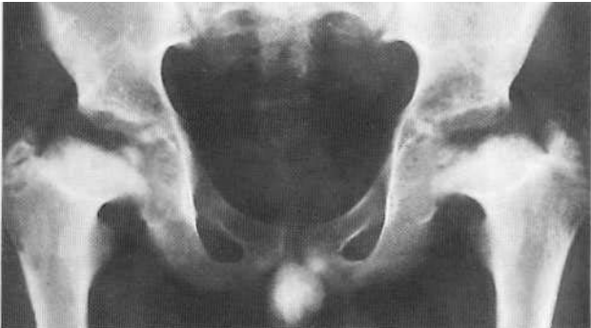
www.drtehreemfatima.com

Slide 18
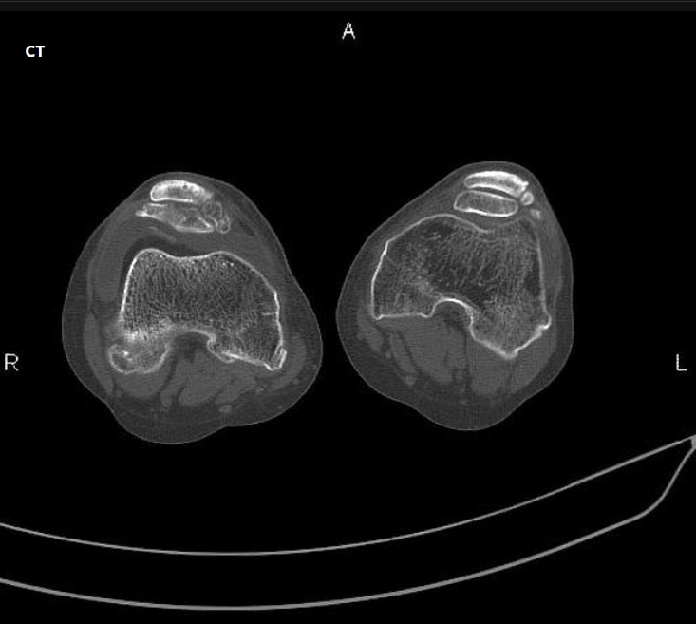
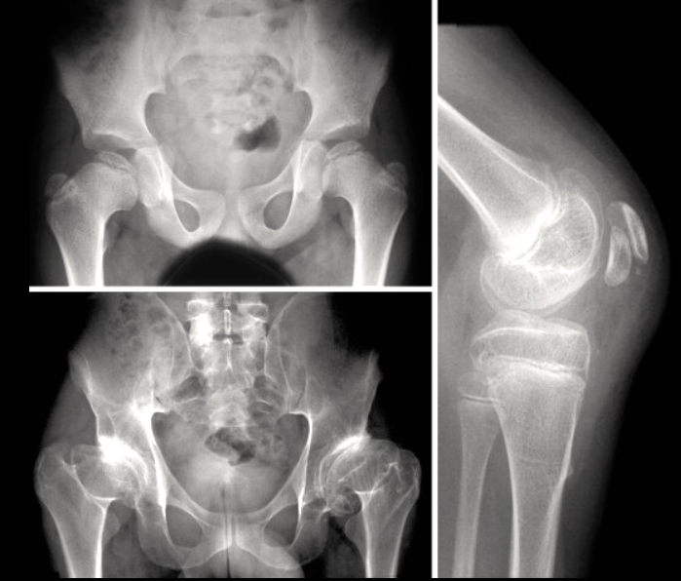
www.drtehreemfatima.com

Slide 19
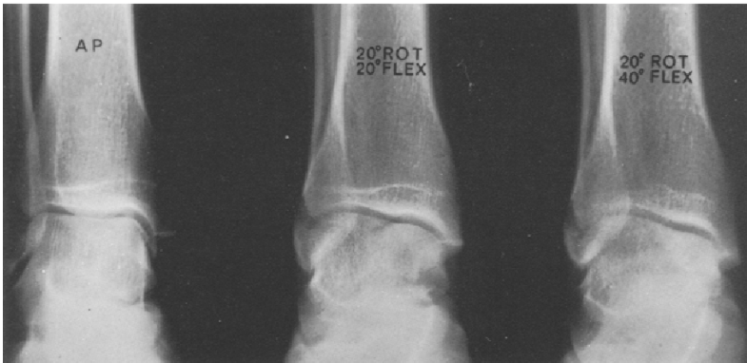
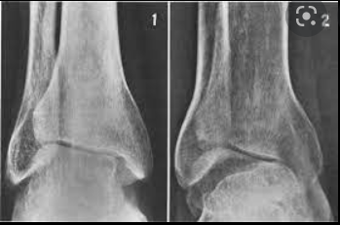
www.drtehreemfatima.com

Slide 20
Dysplasia Epiphysiealis HEMIMELICA
Tarsoepiphyseal Aclasis
Trevor’s disease
www.drtehreemfatima.com

Slide 21
Rare
Non hereditary
Osteochondromas
3 types ( classic, localized, generalized)
www.drtehreemfatima.com

Slide 22
Irregular over growth of part of epiphysis
Leg > arm
Lower end of fibula & adjacent talus
Hyperplasia of affected of epiphysis
Chevron deformity occurs
www.drtehreemfatima.com

Slide 23
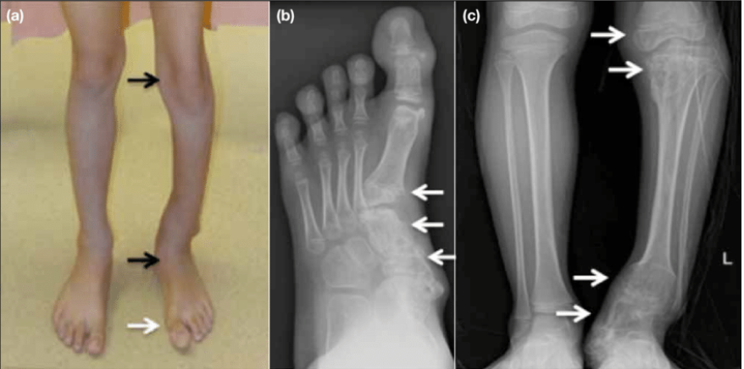

Slide 24
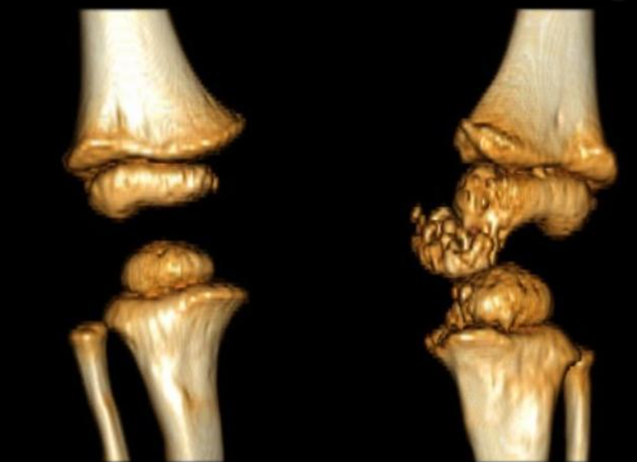

Slide 25
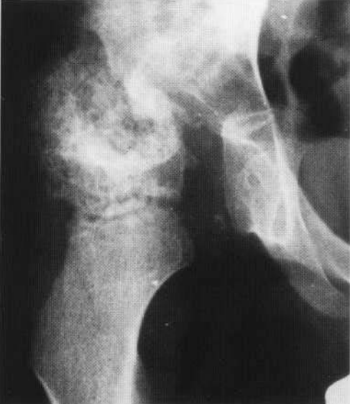

Slide 26
METAPHYSEAL CHONDRODYSPLASIA
Metaphyseal Dysplasia
Metaphyseal dysostosis
www.drtehreemfatima.com

Slide 27
Rare inherited autosomal disorder
Clinical features just like rickets
Genetic analysis needed to differentiate
Multiple forms
www.drtehreemfatima.com

Slide 28
types
Shmid Type
Mild & common
Cupped metaphysis
Mistaken for rickets
Pena & Vaandrager
Intermediate
Resembles Ollier’s disease
Jansen’s Type
Severe type
Gross irregular mineralization of metaphysis
Large gap b/w epiphysis & metaphysis
www.drtehreemfatima.com

Slide 29
www.drtehreemfatima.com
Associated with
    Pancreatic insuffiecieny
    Neutropenia
Sometimes with spinal lesions
    Spondylometaphyseal dyostosis
Amish families
    Cartilage-hair-hypoplasia

Slide 30
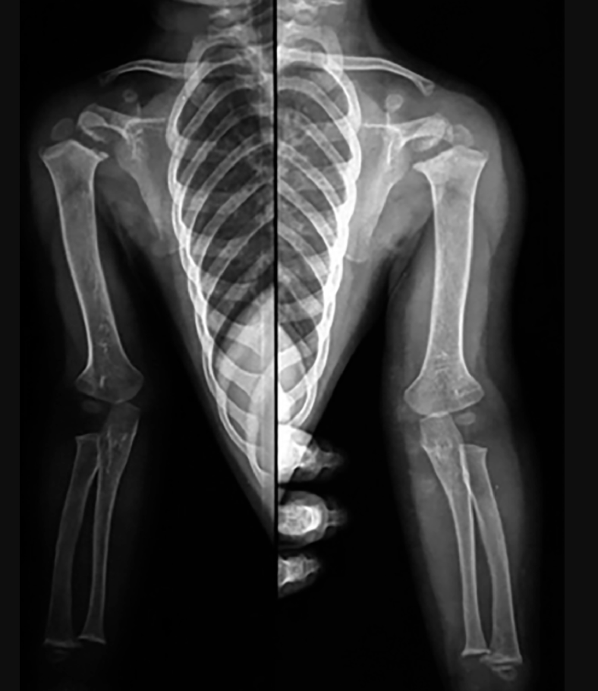
Schmid type

Slide 31
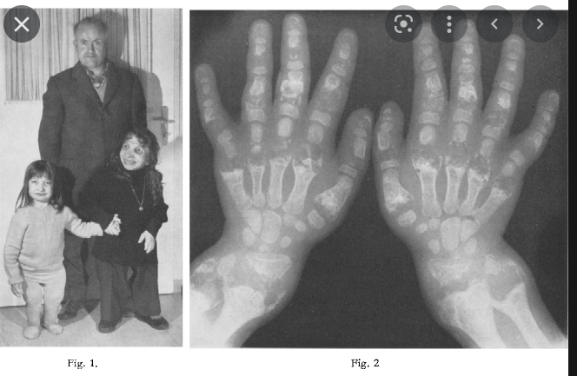
Janssen type

Slide 32
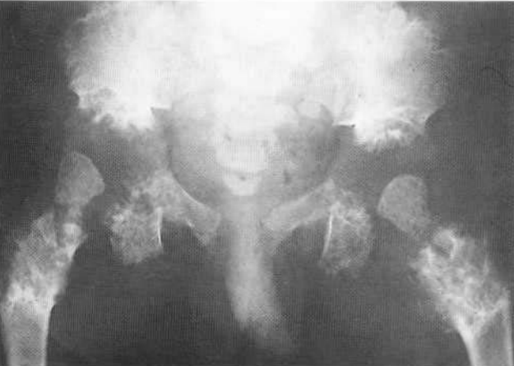
Janssen type

Slide 33
ACHONDROPLASIA
www.drtehreemfatima.com

Slide 34
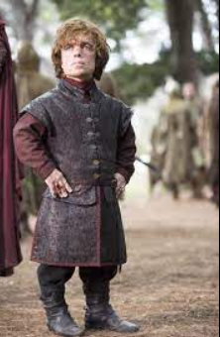
Most common disproportionate dwarfism (1/25,000 births)
Autosomal dominant
Gene mutation seen in (85%) older fathers
Normal intelligence ( lack of muscle tone at birth can deceive) www.drtehreemfatima.com

Slide 35
types
Rhizomelia
Mesomelia
Acormelia
www.drtehreemfatima.com

Slide 36
CLINICAL FEATURES
Short limbs
Trident hands
Stubby fingers
Depressed nasal bridge
Prominent forehead
Large skull ( can obstruct labor)
Prominent hips due to lumbar lordosis
www.drtehreemfatima.com

Slide 37
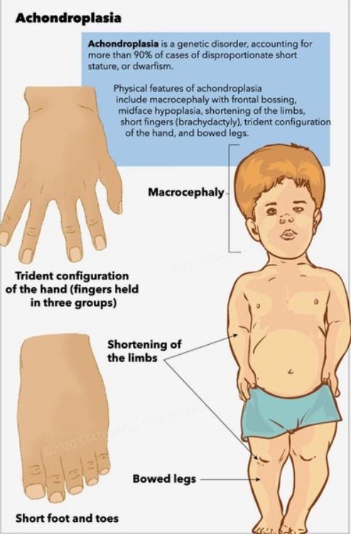
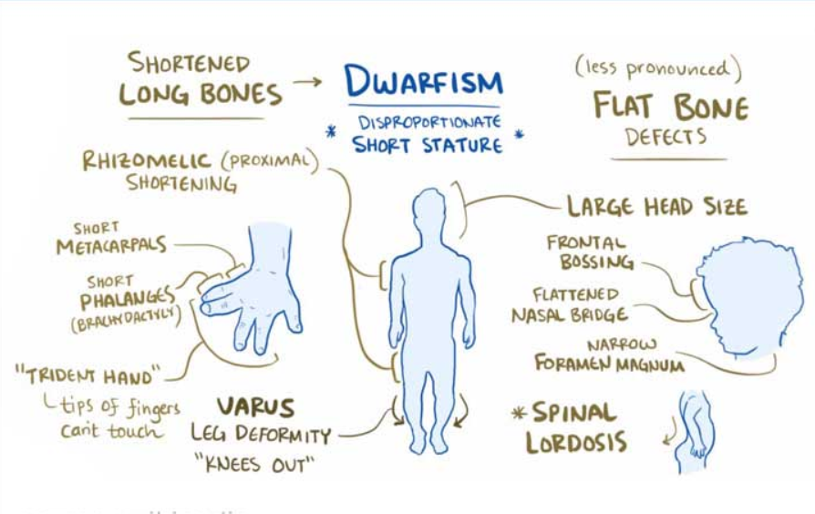

Slide 38
Radiological features

Slide 39
Long bones
Short & wide
Prominent muscle insertions
Rhizomelia more common
Long and bowed fibula
V-shaped defects at metaphysis & epiphysis
Chevron sign
Reduced AP diameter of femora (radiolucent)
www.drtehreemfatima.com

Slide 40
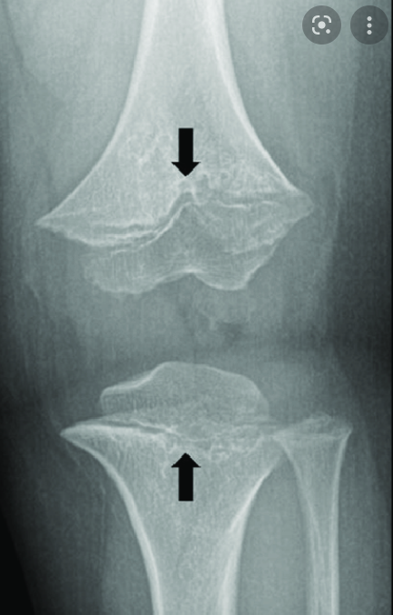
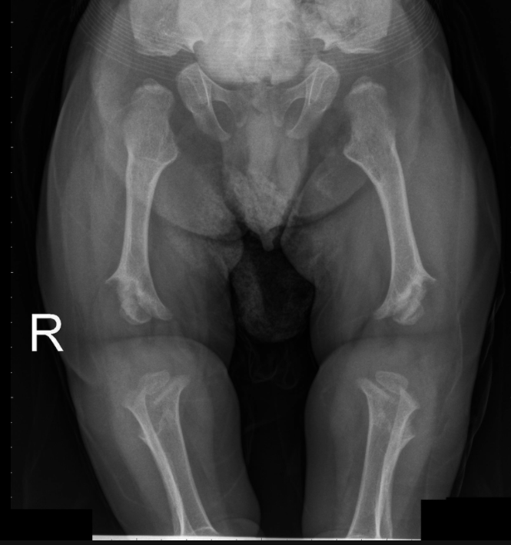

Slide 41
pelvis
Small
Iliac plates – square (tombstone appearance)
Posterior acetabula with horizontal roof
Excessive pelvic tilt
Narrow Sacro sciatic notch with prominent med spur
Pelvic inlet – champagne glass
www.drtehreemfatima.com

Slide 42
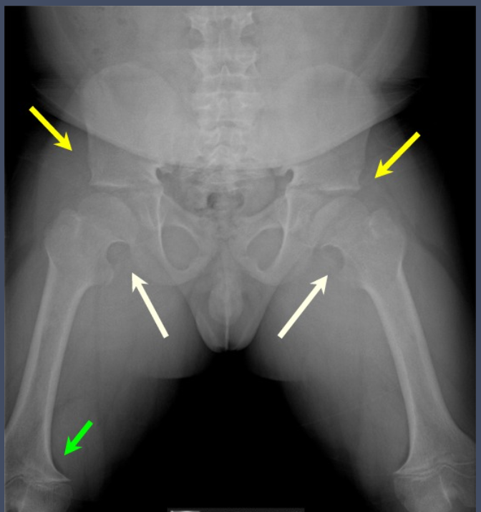
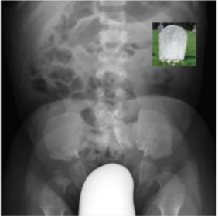

Slide 43
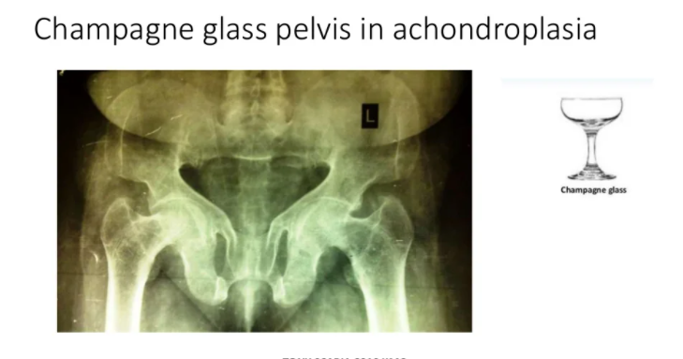

Slide 44
SPINE
Short AP diameter
Reduced I/V heights
Bullet-nosed/wedge shaped vertebra (thoracolumbar region)
Scalloping at back of vertebrae
Spinal canal tapers/reduced interpedicular distance (lumbar)
High risk for disc protrusion
www.drtehreemfatima.com

Slide 45
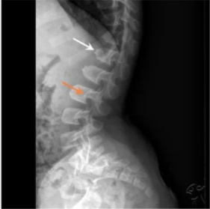
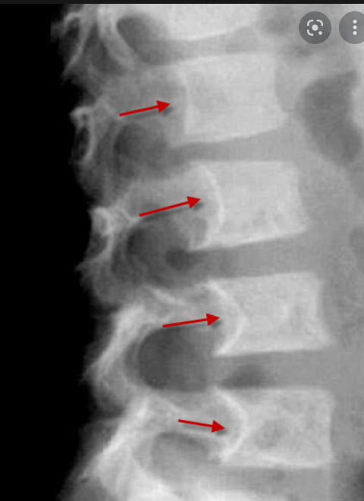
www.drtehreemfatima.com

Slide 46
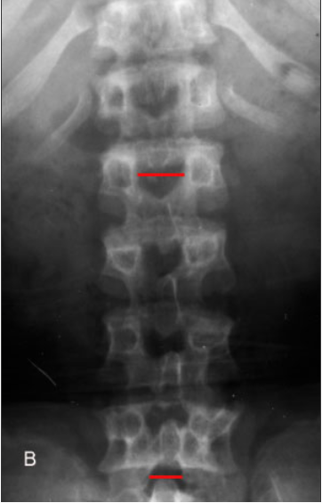
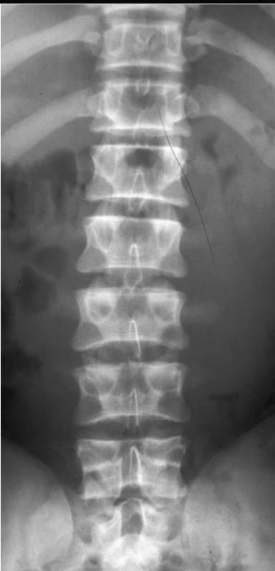

Slide 47
SKULL
Large calvarium with short base
Small sella
Small & funnel shaped foramen magnum
Hydrocephalus may occur
www.drtehreemfatima.com

Slide 48
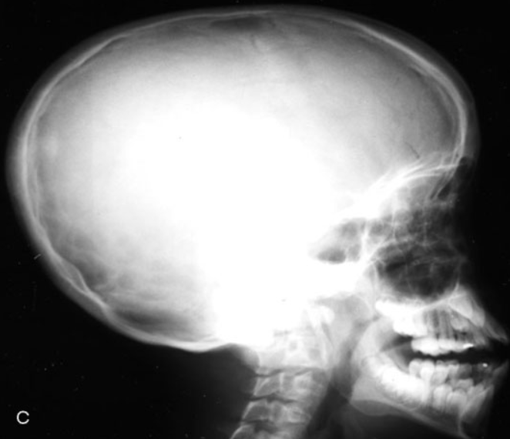

Slide 49
CHEST
Short ribs
Widened anterior ends
Short & wide sternum
Scapulae – lost sharp edges
Small glenoid fossae
www.drtehreemfatima.com

Slide 50
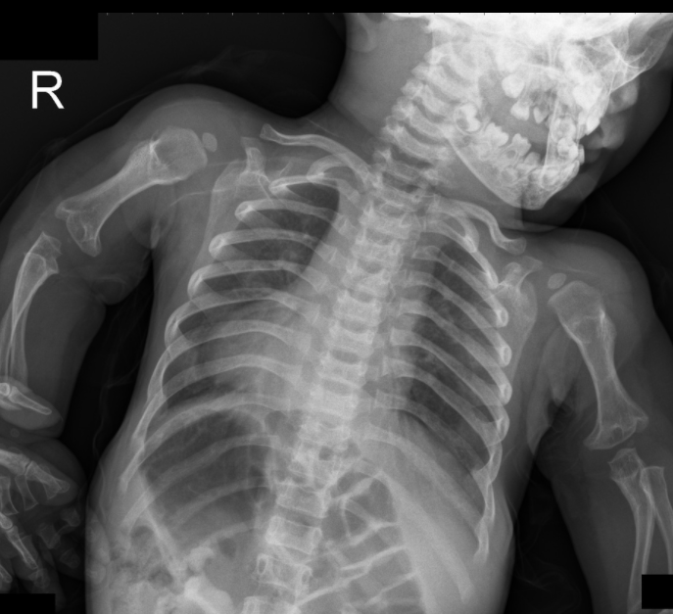

Slide 51
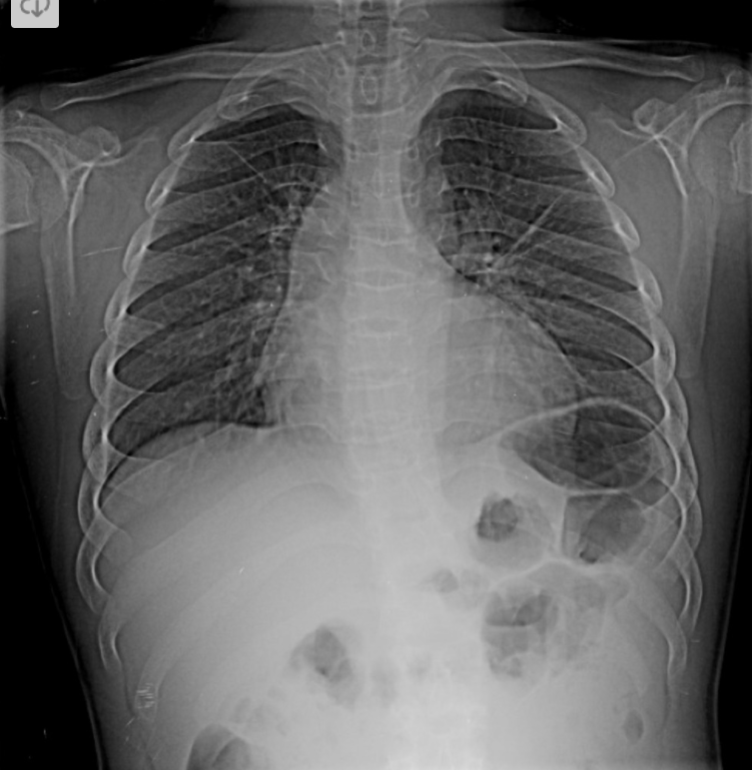
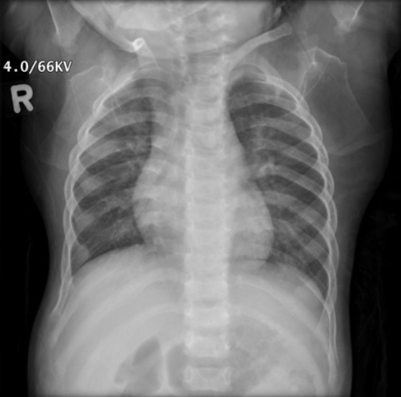

Slide 52
HANDS & FEET
Long bones, wide and short
Trident hand
Carpel & tarsals unaffected
www.drtehreemfatima.com

Slide 53
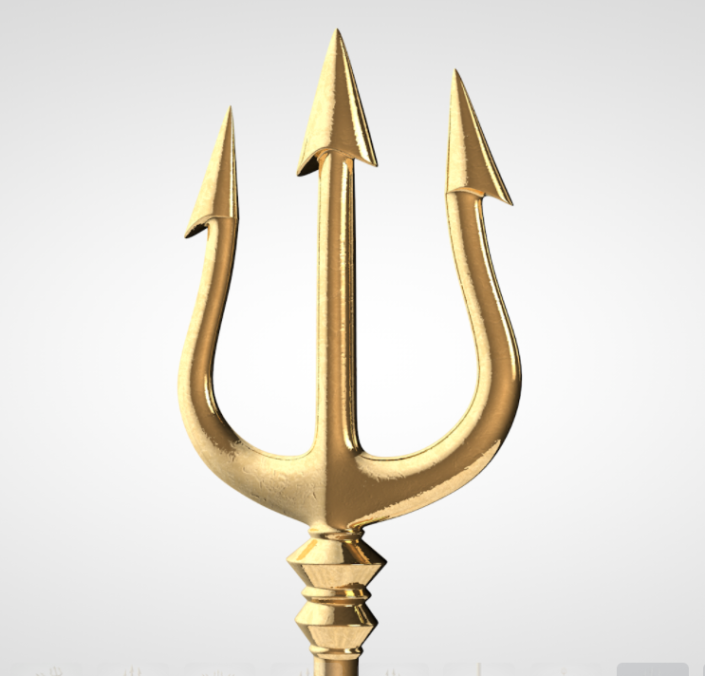
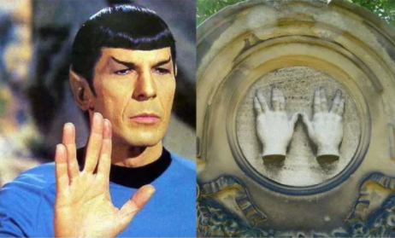

Slide 54
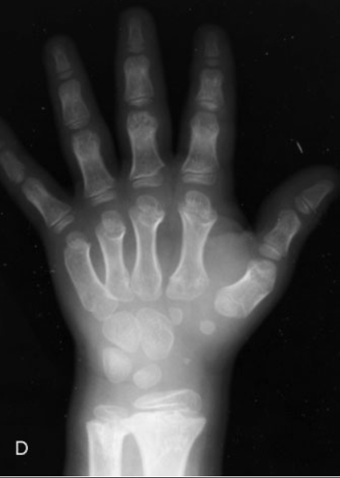
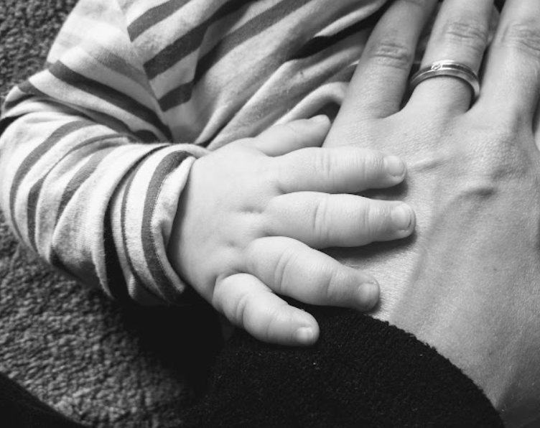

Slide 55
HYPOCHONDROPLASIA

Slide 56
Skull is never affected
Normal or mildly reduced height
Dominant inheritance
Prominent abdomen and hips
Bowed legs

Slide 57
RADIOLOGICAL FEATURES
Rhizomelia
Short broad femoral neck
Distal fibula over grown
Small ilium
Narrow interpedicular distance
Increased lumbar lordosis
www.drtehreemfatima.com

Slide 58
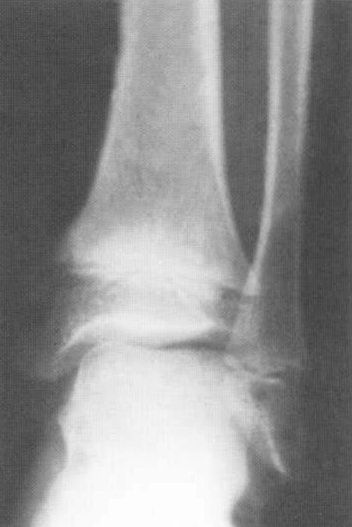
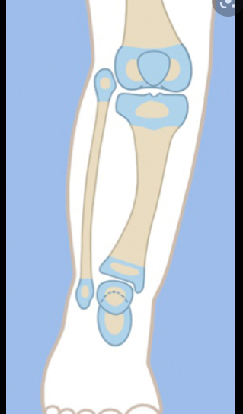

Slide 59
PSEUDOACHONDROPLASIA
www.drtehreemfatima.com

Slide 60
Short limb dwarfism
Recessive and dominant forms
Mild and severe form
No changes in 1st yr of life

Slide 61
RADIOLOGICAL FEATURES
Spine
Flat irregular vertebral bodies
Central anterior tongues
Platyspondyly >> scoliosis
Long bones
Delayed & irregular epiphyseal appearance
Broad spurred metaphysis
www.drtehreemfatima.com

Slide 62
Pelvis
Irregular acetabulum
Premature osteoarthritis
Large ilia
Small ischia and pubes
Hands
Short stubby
Short metacarpals, radius and ulna
www.drtehreemfatima.com

Slide 63
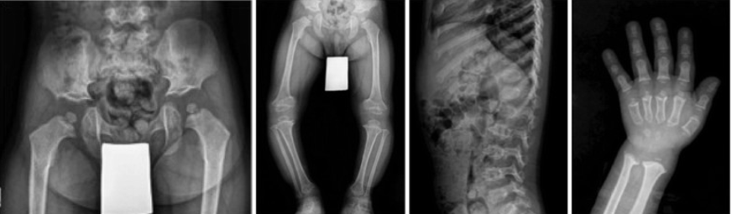

Slide 64
DIAPHYSEAL ACLASIS
Hereditary Multiple Exostosis
www.drtehreemfatima.com

Slide 65
Familial (60% cases have parents also involved)
Equal gender incidence
Long bones esp metaphyseal region of
      Shoulders
      Hips
      Knees
      Ankles
Irregularly expanded, club shaped
Exostoses

Slide 66
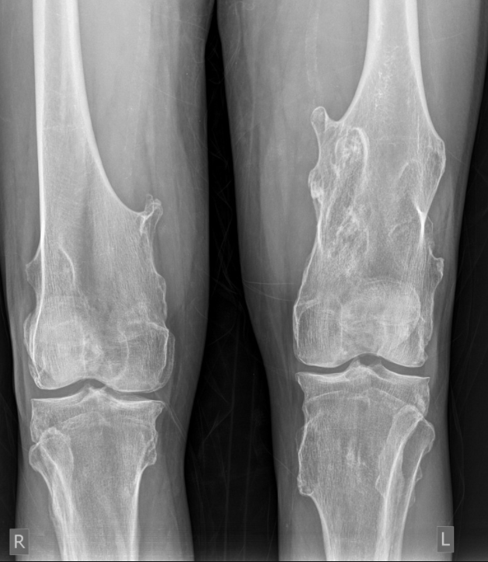
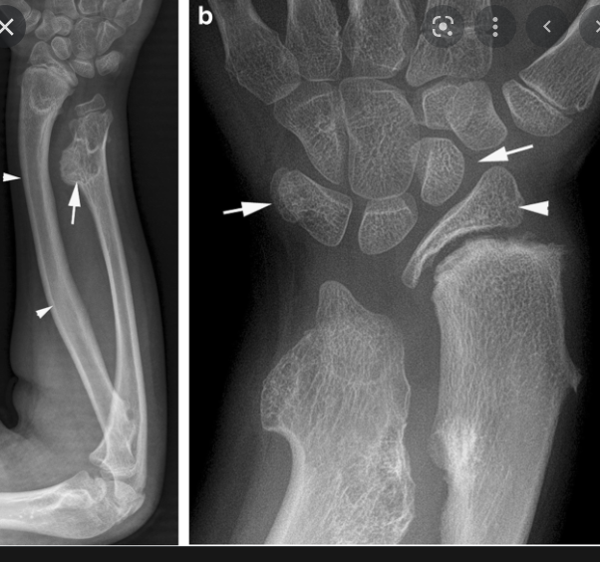

Slide 67
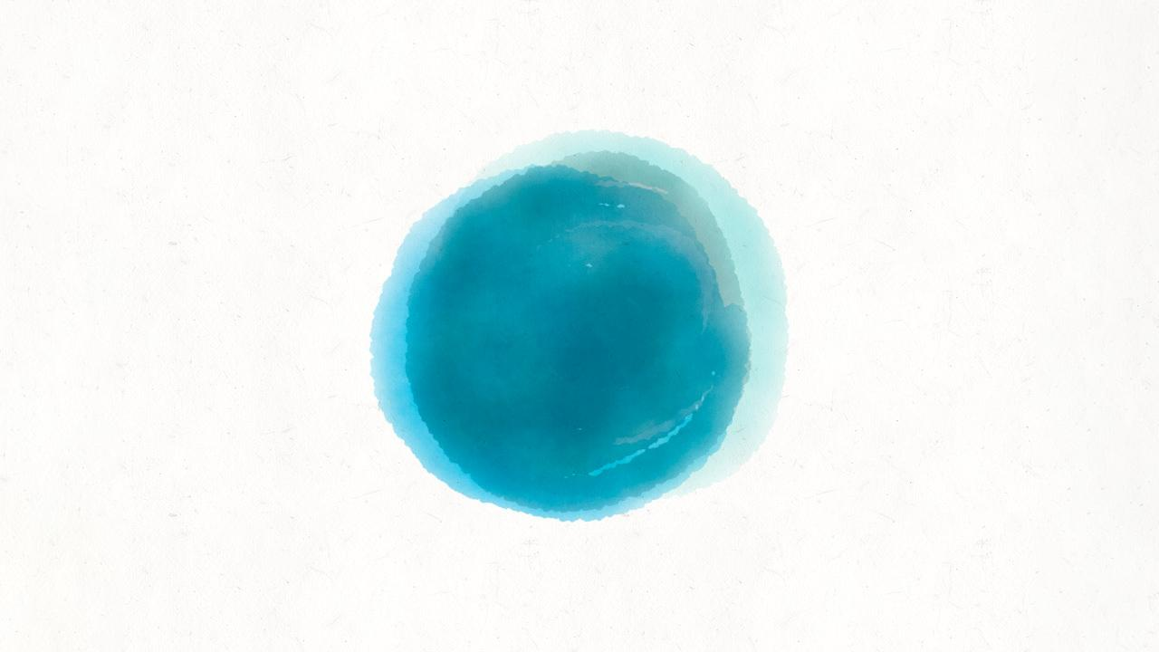
Q/A

Slide 68
A 6-year-old boy is referred to the orthopaedic team with a limp. A pelvic radiograph reveals loss of height of the right femoral head, with fragmentation and sclerosis of the epiphysis. What is the most likely diagnosis?
Developmental dysplasia of the hip
Perthes' disease
Septic arthritis
Slipped upper femoral epiphysis
Transient synovitis of the hip

Slide 69
A 6-year-old boy is referred to the orthopaedic team with a limp. A pelvic radiograph reveals loss of height of the right femoral head, with fragmentation and sclerosis of the epiphysis. What is the most likely diagnosis?
Developmental dysplasia of the hip
Perthes' disease
Septic arthritis
Slipped upper femoral epiphysis
Transient synovitis of the hip

Slide 70
A series of neonatal radiographs reveal a narrow thorax with short ribs, square iliac wings with horizontal acetabular roofs, short sacrosciatic notches, progressive narrowing of the interpedicular distance and posterior scalloping of the vertebral bodies. What is the most likely diagnosis?
Achondroplasia
Campomelic dysplasia
Cleidocranial dysplasia
Ellis-van Creveld syndrome
Morquio's syndrome

Slide 71
A series of neonatal radiographs reveal a narrow thorax with short ribs, square iliac wings with horizontal acetabular roofs, short sacrosciatic notches, progressive narrowing of the interpedicular distance and posterior scalloping of the vertebral bodies. What is the most likely diagnosis?
Achondroplasia
Campomelic dysplasia
Cleidocranial dysplasia
Ellis-van Creveld syndrome
Morquio's syndrome

Slide 72


